Slide 1


Slide 2



This course material by Osama Salah is released under the following license:
Attribution-ShareAlike 4.0 International (CC BY-SA 4.0)
Conditions for use are published here:
https://creativecommons.org/licenses/by-sa/4.0/

Slide 3
Acknowledgement
I would like to thank and acknowledge the following people for their valuable contributions to this course material:
Have your name and effort acknowledged here!!!

Slide 4
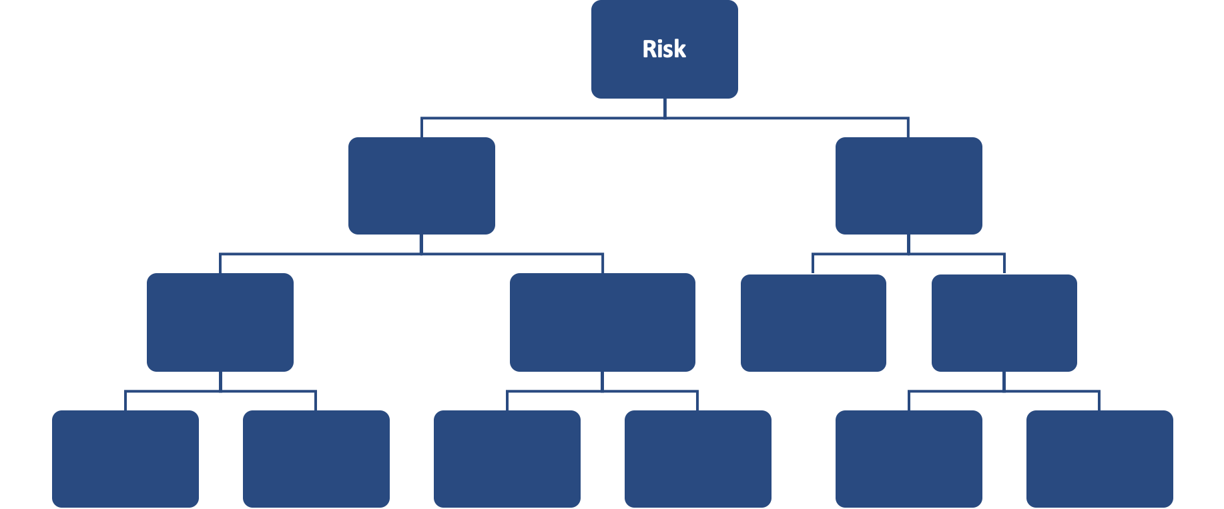
FAIR Open Course Module 4 – Data Gathering Ver. 0.1 / Last Update: 14/09/2019

Slide 5
FAIR Risk Analysis
In the past model we have scoped and framed our risk analysis. In this module we will focus on collecting the necessary data to feed into the model.

Slide 6
The Scenario
Analyze the risk associated with cyber criminals attacking our campaign material repository using ransomware to encrypt the data and locking out workstations.
Asset | Threat | Effect
Campaign Material and CRM system | Cyber Criminals | Availability

Slide 7
Subject Matter Experts
We need to assemble a team for the risk analysis.
The SME’s can be selected considering:
Asset
Threat
Effect
Loss Types

Slide 8
Subject Matter Experts
Asset
Who is the asset owner? Data Owner? Data Custodian?
The asset is used in which process? Who owns that process?
Threat
Who has insight into the threat community?
Who might have dealt with them in past?
Effect
Who has the most interest in avoiding this particular effect?
For example availability might be of interest to COO or BCM, confidentiality might be of interest to legal advisors, privacy officers etc.
Loss Types

Slide 9
Subject Matter Experts (LM)
Loss Magnitude (i.e. Loss Types)
Loss Type | SME
Productivity | Business Continuity (BIA), Operations, HR
Replacement | Asset owners
Response | Incident Response Team, BCM
Competitive Advantage | Corporate Strategy, R&D, Innovation Management
Reputation | Public Relations, Marketing, Sales
Fines and Judgements | Legal advisors, Regulatory Compliance Managers

Slide 10
Subject Matter Experts
You can always invite additional SMEs as you work yourself through the scenario and feel there are gaps that others can help address.
When there are areas of high uncertainty, due to lack of insights from SMEs, missing corporate capabilities (process, people or technology) then these must be specifically documented. Hiding our uncertainty serves no one.
Talking openly about our uncertainty might lead to revelation of other untapped data sources or management allocating resources to address the uncertainty.

Slide 11
Where do we start?
?
?
Risk
Loss Event Frequency
Threat Event Frequency
Vulnerability
Loss Magnitude
Primary Loss
Secondary Risk
Secondary Loss Event Frequency
Secondary Loss Magnitude
Contact Frequency
Probability of Action
Threat Capability
Difficulty

Slide 12
Where do we start?
There is no fixed rule on whether to start with the frequency side or loss magnitude side. There is no right or wrong answer.
Starting with loss magnitude might sometimes be easier because you typically have more insight into the loss estimates.
Starting with the frequency side could be more useful to help you understand the scenario better since it includes all the variables (other than loss magnitude) that lead up to a loss event.

Slide 13
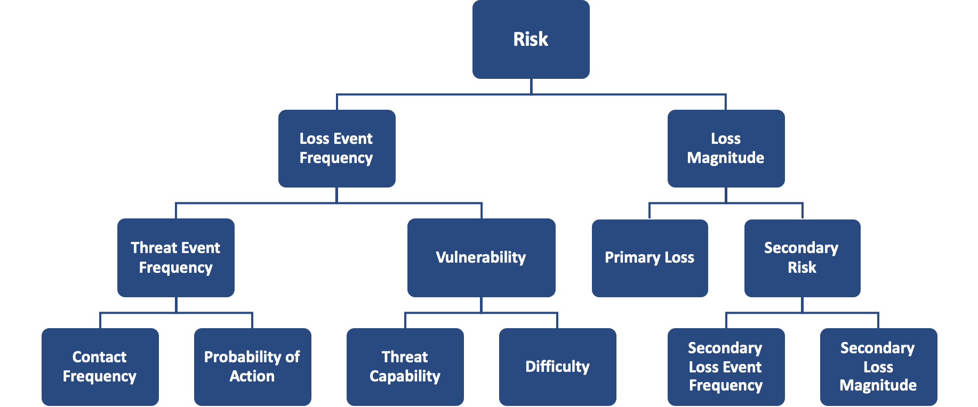
How deep do we go down the rabbit hole?
We always prefer to stay on the higher levels as long as we have sufficiently accurate estimates.
Decomposing risk with even more inaccurate estimates will result in inaccurate analysis.
Nonetheless, it’s useful to review all the variables to ensure our thinking matches the model.
When thinking about the scenario use the model for guidance. One major advantage of using a good model, is that it can make us take notice of something we were not previously considering.

Slide 14
Analysis Approaches
There are essentially two approaches to the analysis.
1. Open Brainstorming first, then mapping to the model
This is similar to an open brainstorming session where all ideas are collected and evaluated later for suitability for the analysis. This approach is suitable if the building blocks of the scenario are unfamiliar. For example in our case we will be talking about ransomware and many might not fully understand what it is or have misconceptions on what it is.
This approach could use a mind map, white board, post-it notes…

Slide 15
Mind map Example

Slide 16
Analysis Approaches
2. Map to the model
In this approach we directly map our inputs to the model. Usually participants are very familiar with the scenario and its components.
Even if you start with brainstorming you will then follow it with mapping to the model.

Slide 17
Analysis Approaches
In either approach the beauty of using a model is that there is no judgment, there is no right or wrong.
All participants are basically focused on finding the best sources of data, the discussion is on the quality of data and how it fits the model.

Slide 18
Starting with Loss Event Frequency
In this example we choose to start with the loss event frequency side.
It is always good to start with a more general understanding of the scenario. Look at the bigger picture then focus on the details.
At the center of the scenario we have “Ransomware”.
What do we know about Ransomware?

Slide 19
Ransomware
Ransomware is a form of malware.
Ransomware encrypts files and locks up computers.
Once the ransom is paid (through cryptocurrency) the hacker promises to release the decryption key.
There is no guarantee that the decryption keys will be released or that they will work.
Sometimes the encryption is implemented badly and cyber security companies offer free decryption keys. https://www.nomoreransom.org.
We assume in this scenario that there is no free encryption available.
Ransomware is typically opportunistic in nature i.e. the cyber criminals do not specifically target companies.

Slide 20
Ransomware
Infection happens similar to any other malware infection i.e. it is initiated by the user i.e. by clicking on a malicious link, visiting a malicious or compromised website or opening an email attachment.
Ransomware controls are typical malware protection controls they include:
Technical controls such as antivirus and antispam solutions, backup
Process controls such as incident response plans…
Cyber Security “Hygiene” or system hardening: Disable macro scripts, patch systems, least privilege and network segmentation
End user training addressing phishing and social engineering

Slide 21
Paying the Ransom
Paying the ransom is always an option victims have to consider.
This turns out to be a rather difficult question. Tony Martin-Vegue wrote a detailed article on that topic in the ISACA Journal (behind a paywall).
Summary is available here:
Decision Analysis of Ransomware Incidents
Pay Or Not Pay A Ransom? It’s Not That Simple
Full article here:
The Downstream Effects of Cyberextortion
In this scenario we assume the company refuses to pay the ransom.

Slide 22
Estimating Loss Event Frequency
This is a question where we need to involve the right subject matter experts.
We can look at sources of information inside the organization and reconcile that with information from outside the organization.
When we elicit information we need to frame questions in plain and straight forward business terminology. We are not going to ask “So what is the threat event frequency in this scenario?”

Slide 23
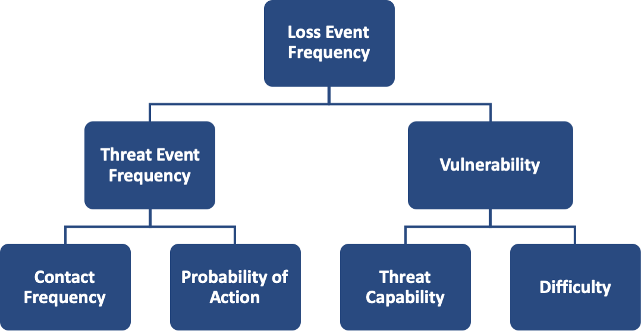
Ransomware in the Organization
Loss Event Frequency
The questions in plain English would be:
“How many ransomware loss events do we expect to experience in the next 12 months”?
Or if we are trying to figure out if we have historic data:
“How many ransomware loss events have we experienced in the last 12 months?”

Slide 24
Ransomware in the Organization
Threat Event Frequency
The questions in plain English would be:
How many ransomware incidents do we expect to prevent from causing harm in next 12 months?
Or if we are trying to figure out if we have historic data:
How many ransomware incidents were prevented before they could cause harm in the last 12 months?

Slide 25
Ransomware in the Organization
We mentioned that ransomware is typically opportunistic and triggered by end user action, thus investigating Contact Frequency (CF) and Probability of Action (PoA) do not appear to be that useful.
In our case the contact type is assumed to be “Random”
Random
Regular
intentional

Slide 26
Assumptions so far
We consider ransomware as a type of malware.
Any malware infection could potentially have been a ransomware infection. Or any malware bypassing our controls could have bypassed ransomware. We are as vulnerable to ransomware as we are to malware in general.
Every ransomware loss event will encrypt files and lock the endpoint.
The threat actor is opportunistic i.e. this is not a targeted attack, it’s a random attack. Contact Type is “Random”. We are not saying that ransomware could not be targeted, or that cyber criminals won’t increase effort etc. once they have penetrated an organization and realize the potential to expand and extort. We are just saying that in this scenario SMEs feels they are a low profile organization and unlikely to be targeted.
Notes:
At a certain time Hospitals were a preferred target, then that seems to have shifted to municipalities…

Slide 27
Ransomware in the Organization
We are vulnerable when controls fail (or don’t exist) then TEF turns into LEF.
Ransomware has to get through our existing defenses/controls..
If ransomware is a type of malware then data on prevented malware (TEF) and non-prevented malware (LEF) could be used to derive vulnerability.
Not all malware is ransomware, but can we get a source stating ratios i.e. what percentage of malware if ransomware?

Slide 28
Ransomware in the Organization
Just a thought:
We assumed we will treat ransomware the same as any other malware.
Another approach, could have to research if there is data to help estimate how many ransomware infections are typically recorded compared to all other malware infections.

Slide 29
Ransomware in the Organization
The organization has last year recorded 15 malware infections (ransomware and others). These required workstations to be re-imaged.
The organization has a total of 500 workstations and laptops.
About 50 of those are critical for the operation. They all have access to the same critical file repositories. Any of those machines infected with ransomware would be capable to encrypt all files.
5 of those machines were among the 15 infected machines in the last 12 months.
!
In hindsight limiting the analysis to only the 50 machines that are used in critical processes appears to be not accurate.
For example even machines that are not critical will need to be recovered/restored.
For now just go with it and in a future version I will refine the scenario.

Slide 30
Ransomware in the Organization
OK, we collected some data through brainstorming and talking to SMEs. But, what is useful and what isn’t?
What do we map to the model?

Slide 31
Ransomware in the Organization
The organization has a total of 500 workstations and laptops.
About 50 of those are critical for the operation. They all have access to the same critical file repositories. Any of those machines infected with ransomware would be capable to encrypt all files.
The organization has last year recorded 15 malware infections (ransomware and others). These required for workstations to be re-imaged.
5 of those machines were among the infected machines in the last 12 months.
The company has 500 workstations, but we really care only about 50 out of the 500.
Since we reasoned that this is a random attack any of these 50 critical machines is as likely to be infected as any of the other 450.

Slide 32
Ransomware in the Organization
15 malware infection (maybe useful?)
5 critical machines infected last year (useful) → Loss Event Frequency
The organization has a total of 500 workstations and laptops.
About 50 of those are critical for the operation. They all have access to the same critical file repositories. Any of those machines infected with ransomware would be capable to encrypt all files.
The organization has last year recorded 15 malware infections (ransomware and others). These required for workstations to be re-imaged.
5 out of the 15 infected machines where critical machines.

Slide 33
Ransomware in the World
What do we know about ransomware in the rest of the world?
Do we know anything about it in our industry?
We can basically start googeling “Ransomware” and see what we can find.
We need to be careful and distinguish between reliable and unreliable sources.
Many sources are written by marketing departments with the main intention to push their solutions.
Many news sources exaggerate with news worthy headlines for the sake of the clicks.
Ensure the information is still relevant and not outdated.

Slide 34
External Data Sources
The Verizon Data breach Investigations Report is always a good source. It includes a large data set and is prepared by a very professional team. It has been maintained over many years which also supports trending and comparisons.
Reports published by the Cyentia Institute are always an excellent source. So are the third party reports they include in their library.
Internet Security Threat Reports, State of Cyber Security Reports published by vendors (typically quarterly and yearly)
Ask friends or post to the FAIR Institute community asking for sources others might have used.

Slide 35
Ransomware in the World
From the 2019 Verizon Data breach Investigations Report we learn:
In terms of malware incidents Ransomware is #2 (28%) right after C2 malware (Command and Control) (47%).
If our organization is not an outlier out of 100 malware incidents we should be recording about 28 ransomware incidents.
Be careful not to make any absolute inferences. Most data sources are only used to inform our estimation.
We haven’t found much useful information on Cyentia Institute Website.

Slide 36
Ransomware in the World
Microsoft Security Intelligence Report January – December 2018 mentions that in 2018 “ransomware encounters” have dropped compared to 2017 (peak 0.11% in 2017, 0.03% in Dec. 2018)
Not clear what exactly is an “encounter”.
Trend seems to be dropping, but will downwards trend continue in 2019 and beyond?
FireEye on the other hand says ”We saw an uptick in financially motivated compromise such as ransomware and business email compromise…”
Recorded Future says “While the number of ransomware variants continues to expand rapidly, the truth is that most of these campaigns are ineffective and die out quickly.”
IBM says “However, more recently, criminals seem to use less ransomware…”

Slide 37
Ransomware in the World
As we can see we have to be careful.
Don’t fall for “Confirmation Bias” and stop researching after just a few sources that appear to confirm our own intuition.
Be clear on what data exactly the researchers base their opinion.
Companies will typically base their reports on the data they have access to which is limited to their service offering. This might be broad for some and very limited to others.
We can of course expand our research to more sources, but for now we conclude that ransomware is generally dropping or at least not increasing.

Slide 38
Estimating LEF
The experts estimate the frequency of a machine getting infected with ransomware during the next year as:
But in real life you will have several SMEs each making different estimates that need to be reconciled.
LEF
Min | ML | Max
2 | 3 | 5

Slide 39
Combining SME Opinions - Brainstorming
The simplest method is to bring all SMEs together, present all the different estimates and agree not to leave the room until they all agree on an estimate they can live with.
That could work if you have a good facilitator and there aren’t too many outliers and people are willing to listen to each other and update their estimates.

Slide 40
Combining SME Opinions - Averaging
Combining SME estimates by averaging isn’t 100% mathematically sound but it’s easy and gives reasonable results.
The result is again three value that can be used as inputs in a computational engine that expects input in the min, ml, max format.
 | Min | ML | Max
SME1 | 2 | 15 | 25
SME2 | 4 | 12 | 22
SME3 | 3 | 17 | 30
Average | 3 | 14.6 | 25.6

Slide 41
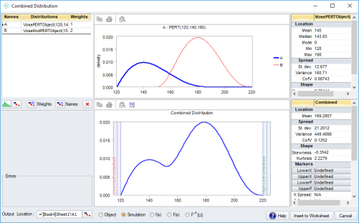
Combining SME Opinions - Distributions
Another method could combine the distributions and create a combined distribution while given different weights to different SMEs.
ModelRisk from Vose Software for example offers a function “VoseCombined” that does that.
But the result would be a new distribution and not 3 values for min,ml,max.
https://www.vosesoftware.com/riskwiki/VoseCombined.php

Slide 42
Loss Magnitude
Let’s recall the different loss types and focus first on the primary losses
Loss Type | Primary Loss | Secondary Loss
Productivity | ✭
Replacement | ✭
Response | ✭ | ✭
Competitive Advantage |  | ✭
Reputation |  | ✭
Fines and Judgements |  | ✭

Slide 43
Loss Magnitude
Productivity
So what would happen when a workstation is locked out and our data is encrypted? How would that affect productivity?
It might delay submission of deliverables to customers, but how does that translate into a loss? Maybe penalties will have to be paid? Maybe customer gets upset and it will affect future business?
The user might sit idle doing nothing (although realistically there is always something useful to do that might not need a workstation or access to files).
Always start with broad data collection like:
How much is the average employee paid (one of the employees using a ‘critical’ workstation)?
How many projects do we typically handle in a year?

Slide 44
Loss Magnitude
We must have some projects that are in early stages and we can accept and deal with delay. We probably can catch up quickly after recovery is finalized. How many of these would our customers be accommodating and how many customers would just terminate the contract?
But, we probably have also some projects that are already at late stages and on-time delivery is critical to the customer. Customer is unlikely to terminate but there might be penalties for late delivery (which might fit better under Fines and Judgements) or maybe it will have a more serious impact on future business?

Slide 45
Loss Magnitude
Projects Per Year: 10,15,30 (Min, ML, Max)
Projects running at the same time: 5,10,15 (Min, ML, Max)
To start making more sense we need to start figuring out what that means in terms of probable loss magnitude.
How do we get to define estimates for the LM?

Slide 46
Loss Magnitude – Replacement and Response
We can turn again to SME’s and ask how much time and effort would be required to recover 50 workstations.
The IT Department estimates that they would need to procure and install new hard drives and re-deploy the critical applications. They estimate this to take between 3 to 5 days but most likely 4. (3,4,5)
The cost of a hard drive is about $45 (x50 -> i.e. total cost $2250).
The IT department would need some help but many non-IT staff members are tech-savvy and would not mind to help installing the drives. Worst case they would hire two support engineers for $800 per day i.e. ($2400,$3600,$4000)

Slide 47
Loss Magnitude
How many workstations/users are in our scope? 50
How many people are involved in the recovery? 1 – 2 people
What is the salary of an employee?
Yearly ($50K,$70K,100K) or
Daily ($192,$270,$384)
Days to recover 50 workstations? (6,8,10)
Cost to recover 50 workstations? ($2400,$3600,$4000)
Cost of Hard drive replacement? $2250
How many contracts might we loose? (1/50, 1/30, 1/20)(2%,3%,5%)
Profit from contracts? ($300K,$450K,$9800K)

Slide 48
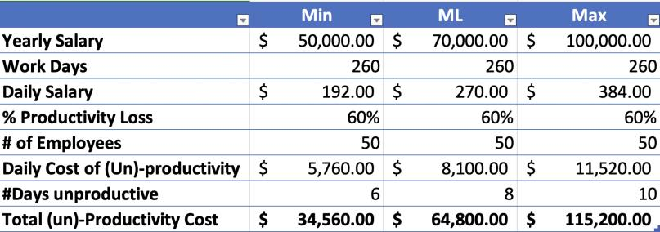
Primary Losses
Loss Type | Primary Loss
Productivity (employee idle time)

Slide 49
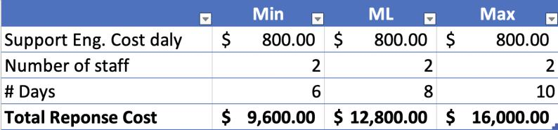
Primary Losses
Loss Type | Primary Loss
Productivity (lost revenue) | NA (will be addressed under secondary losses)
Replacement (50 HDs) | $2250
Response

Slide 50
Secondary Losses
Loss Type | Secondary Loss
Response | NA | We are not expecting to having to respond to the reactions of secondary stakeholders.
Competitive Advantage | NA | There is no loss of competitive advantage
Reputation | $300K, $450K, $900K | We suspect that some customers might take some business elsewhere due to a perceived bad reputation
Fines and Judgements | NA | We do not expect fines and judgements i.e. law suits etc.

